Slide 1

28 June 2022, Vienna, Austria
Faculty: Dr Michael Guger, Dr Sohaib Imtiaz
READY FOR WHAT’S NEXT:
AGILE MANAGEMENT
WITH PONVORY®▼
(ponesimod)
▼This medicinal product is subject to additional monitoring. This will allow quick identification of new safety information. Healthcare professionals are asked to report any suspected adverse reactions. See section 4.8 of the SmPC for how to report adverse reactions.
Prescribing information can be found at the end of the presentation.
Products mentioned in this document may not be registered in all countries. Prescribing information may vary per country. Health Care Providers must refer to their country prescribing information.
Notes:
Dr Imtiaz: Welcome

Slide 2

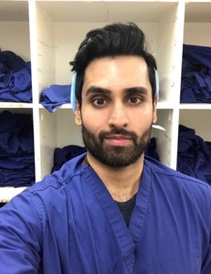
INTRODUCTIONS:
MEET THE EXPERTS
Dr Michael Guger
Neurologist
Dr Sohaib Imtiaz
MD, board-certified (lifestyle medicine),
MSc public health
Oberösterreichische Gesundheitsholding
GmbH Pyhrn-Eisenwurzen Klinikum,
Steyr, Austria
NHS Clinical Entrepreneur Fellow
Host of the human behaviour show
Manchester, England
Notes:
Dr Imtiaz: Dr Imtiaz to introduce himself and then pass over to Dr Guger to give his introduction.

Slide 3
DISCLOSURES FOR DR GUGER
Michael Guger received support and honoraria for research, consultation, lectures and education from Alexion, Almirall, Bayer, Biogen, Celgene, Genzyme, Janssen, MedDay, Merck, Novartis, Roche, Sanofi Aventis and TEVA ratiopharm.
Notes:
Dr Imtiaz: To be briefly mentioned and slide paused on for 5 seconds so audience can read

Slide 4
DISCLOSURES FOR DR IMTIAZ
Sohaib Imtiaz works for a third-party company as a medical advisor.
Notes:
Dr Imtiaz: To be briefly mentioned and slide paused on for 5 seconds so audience can read

Slide 5
DISCLAIMER
This promotional content is intended/approved for HCPs within Europe only. Products may not be available/approved in all countries. Prescribing information may vary depending on local approval in each country.
Therefore, before prescribing any product, always refer to local materials such as the prescribing information and/or the Summary of Product Characteristics (SPC).
Notes:
Dr Imtiaz: To be briefly mentioned and slide paused on for 5 seconds so audience can read

Slide 6
PONVORY® INDICATION
PONVORY® (ponesimod) is indicated for the treatment of adult patients with relapsing forms of multiple sclerosis (RMS) with active disease defined by clinical or imaging features.¹
Notes:
Dr Imtiaz: To be briefly mentioned and slide paused on for 5 seconds so audience can read

Slide 7

READY FOR WHAT’S NEXT:
AGILE MANAGEMENT WITH PONVORY®
Agenda
What are the key attributes of PONVORY®?
What are the key efficacy data for PONVORY®?
How is agile management defined?
When would agile management be clinically required?
How does PONVORY® provide agility?
What are the potential benefits of agility that PONVORY®
provides in clinical practice?
Notes:
Dr Imtiaz: Brief summary of what will be covered in the session

Slide 8


Q1: WHAT treatment ATTRIBUTES OF PONVORY®
STAND OUT TO YOU?
PONVORY® OFFERS THE UNIQUE COMBINATION OF:
SUPERIOR EFFICACY
Proven superior efficacy with PONVORY® 20mg
head-to-head vs. teriflunomide 14mg*^{1,2}
+
AGILITY
PONVORY® could give you the agility to adapt to changing clinical circumstances¹
Notes:
Dr Imtiaz: So, to begin, I was interested in finding out what you think PONVORY® brings to the market as a treatment option? What attributes stand out to you?
Dr Guger: The main advantage of PONVORY® compared to other DMTs is the unique combination of being an efficacious treatment and providing agility, which means the possibility to adapt to changing clinical circumstances.

Slide 9
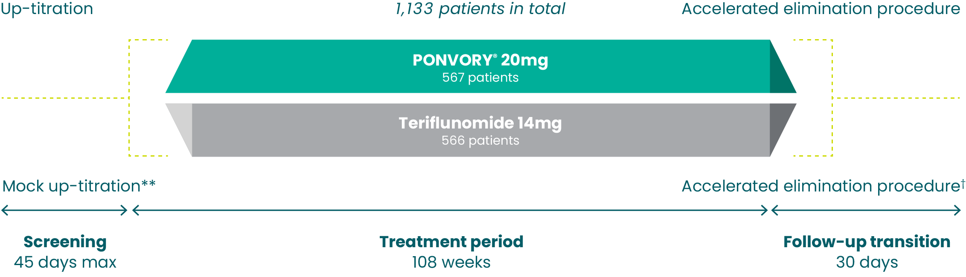
Q1: WHAT treatment ATTRIBUTES OF PONVORY®
STAND OUT TO YOU?
PONVORY® IS THE FIRST ORAL DMT TO DEMONSTRATE SUPERIOR EFFICACY COMPARED TO AN ACTIVE ORAL COMPARATOR, TERIFLUNOMIDE^{*1,2}
OPTIMUM: Phase III study design¹⁻³
Adapted from: Kappos et al. 2021, Kappos et al. 2021, supplement 1 and PONVORY® SmPC.
*Over two years in a large (N=1,133) head-to-head Phase III study in adult patients with active RMS. Primary endpoint: Mean ARRs=0.202 for PONVORY® 20mg vs.
0.290 for teriflunomide 14mg, rate ratio: 0.695 (99% CL: 0.536, 0.902, p<0.001).^{1,2} **In the study, patients underwent a 14-day titration or mock titration at the start of treatment, followed by a once-daily maintenance dose up to Week 108.³ †To accelerate the reduction of teriflunomide plasma concentrations at the end of treatment,
all patients underwent an accelerated teriflunomide elimination procedure with cholestyramine or activated charcoal during the post-treatment follow-up period.³
ARR, annualised relapse rate; CL, confidence limit; DMT, disease-modifying therapy; RMS, relapsing multiple sclerosis.
References: 1. European Medicines Agency. Ponesimod Summary of Product Characteristics. Available at: https://www.ema.europa.eu/en/medicines Last accessed:
June 2022. 2. Kappos L, et al. JAMA Neurol. 2021; 78(5): 558-567. 3. Kappos L, et al. Supplement 1. JAMA Neurol. 2021; 78(5): 558-567.
Notes:
Dr Guger: To expand on the first point, ponesimod is the first oral DMT to demonstrate superior efficacy compared to an active oral comparator, teriflunomide 14mg. For context, the OPTIMUM study was a Phase III, multicentre, double-blind, active-comparator, superiority randomised study in patients with active RMS. In this study, 1133 patients were randomised to receive either once-daily ponesimod 20mg or teriflunomide 14mg over a treatment period of 108 weeks.

Slide 10

Q1: WHAT treatment ATTRIBUTES OF PONVORY®
STAND OUT TO YOU?
ADDITIONAL BENEFITS FOR PONVORY® INCLUDE:
ONBOARD WITH CONVENIENCE
Once-daily PONVORY® can be initiated
at home for most patients*¹
PONVORY® DEMONSTRATED SIMILAR RATES OF OVERALL TEAES
vs. teriflunomide 14mg, with the majority being mild to moderate and not resulting in treatment discontinuation²
*4-hour first-dose observation is recommended for patients with sinus bradycardia, first- or second-degree AV blocks, Mobitz type I (Wenckebach), or a history of myocardial infarction or heart failure occurring more than 6 months prior to treatment initiation and in a stable condition.¹
AV, atrioventricular; TEAE, treatment-emergent adverse event.
References: 1. European Medicines Agency. Ponesimod Summary of Product Characteristics. Available at: https://www.ema.europa.eu/en/medicines Last accessed: June 2022. 2. Kappos L., et al. JAMA Neurol. 2021;78(5):558-567.
Please refer to the PONVORY® SmPC for a full presentation of safety information or speak to one of the booth reps.
Notes:
Dr Guger: Additional benefits of PONVORY® include providing convenience, as it can be initiated at home for most patients and a safety profile, which demonstrated similar rates of overall AEs compared to teriflunomide, with the majority being mild to moderate and not resulting in treatment discontinuation.

Slide 11
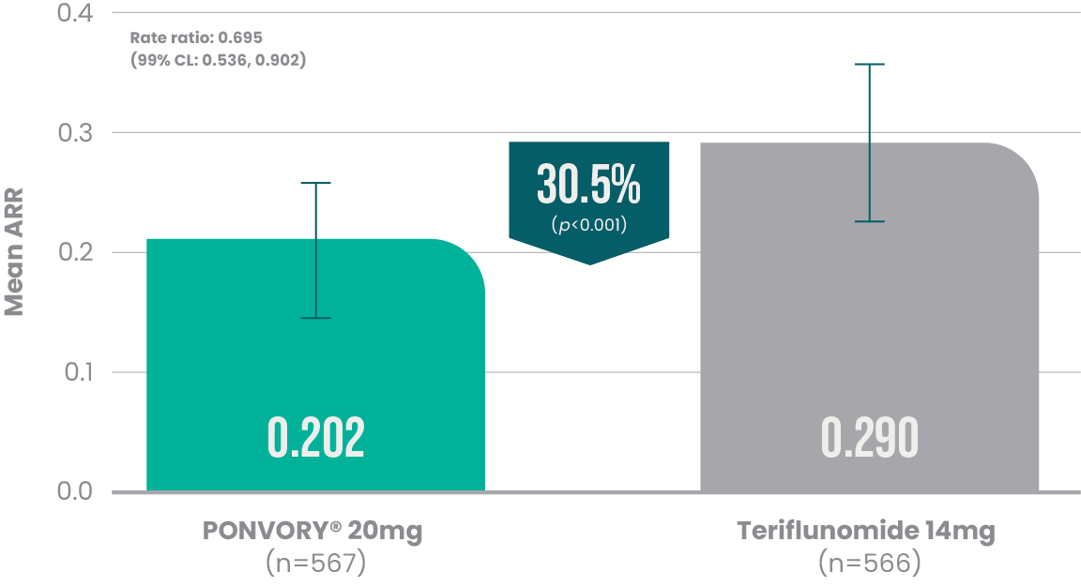
Q2: what are the key efficacy data for PONVORY®?
SUPERIOR EFFICACY WITH PONVORY® VS. TERIFLUNOMIDE*^{1,2}
OPTIMUM PRIMARY ENDPOINT: ARRs up to EOS**²
of patients taking PONVORY®
were relapse-free during
the 2-year Phase III study¹
Adapted from: Kappos et al. 2021.
Adapted from: PONVORY® SmPC.
*Over two years in a large (N=1,133) head-to-head Phase III study in adult patients with active RMS.^{1,2} **ARR was defined as the number of confirmed relapses per patient-year up to EOS.²
ARR, annualised relapse rate; CL, confidence limit; EOS, end of study; RMS, relapsing multiple sclerosis.
References: 1. European Medicines Agency. Ponesimod Summary of Product Characteristics. Available at: https://www.ema.europa.eu/en/medicines Last accessed: June 2022. 2. Kappos L, et al. JAMA Neurol. 2021; 78(5): 558-567.
Notes:
Dr Imtiaz: That’s very interesting, thank you. May I ask you to elaborate on some of the relevant efficacy outcomes?
Dr Guger: Absolutely, beginning with the primary endpoint analysis in the OPTIMUM study, ponesimod demonstrated a 30.5% relative reduction in annualised relapse rate compared to teriflunomide 14mg. This means that 71% of patients taking PONVORY® were relapse-free during the 2-year Phase III study.

Slide 12
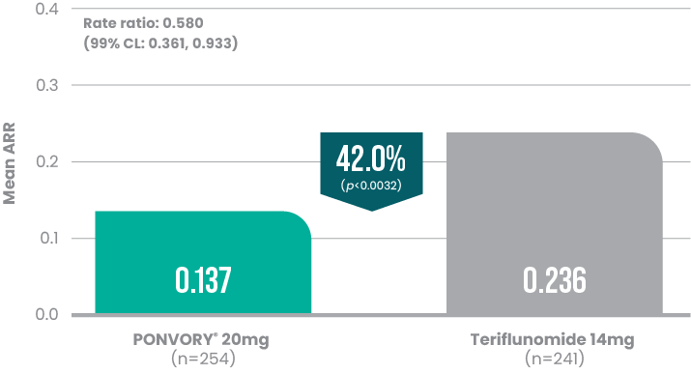
Q2: what are the key efficacy data for PONVORY®?
INCREASED CLINICAL BENEFIT COULD BE SEEN WITH PONVORY® IN PATIENTS WITH EARLY DISEASE*¹
POST-HOC ANALYSIS FROM OPTIMUM: Treatment-naïve patients with an EDSS ≤3¹
Reduction in ARR with PONVORY® vs. teriflunomide 14mg**
in a subgroup of treatment-naïve patients with an EDSS ≤3¹
Adapted from: DiBernando et al. 2021.
Adapted from: DiBernando et al. 2021.
*Clinical benefit measured by both ARR and MRI outcomes in a subgroup of patients in the Phase III OPTIMUM study; patients with early disease=EDSS ≤3 and treatment-naïve.¹ **Mean ARRs in the EDSS ≤3 and treatment-naïve subgroup=0.137 for PONVORY® 20mg vs. 0.236 for teriflunomide 14mg, rate ratio: 0.580
(99% CL: 0.361, 0.933, p=0.0032). Mean ARRs overall population=0.202 for PONVORY® 20mg vs. 0.290 for teriflunomide 14mg, rate ratio: 0.695 (99% CL: 0.536, 0.902, p=0.0003).¹ ARR was defined as the number of confirmed relapses per patient-year up to EOS.²
ARR, annualised relapse rate; CL, confidence limit; EDSS, expanded disability status scale; EOS, end of study; MRI, magnetic resonance imaging.
References: 1. DiBernado A, et al. Presented: 37th Congress of the European Committee for Treatment and Research in Multiple Sclerosis, ECTRIMS 2021, 13-15 October 2021, Vienna, Austria. P359. 2. Kappos L, et al. JAMA Neurol. 2021; 78(5): 558-567.
Notes:
Dr Guger: You could also increase the clinical benefit by using PONVORY® in patients with early disease. In a post-hoc analysis of the OPTIMUM study, ponesimod reduced ARR by 42% compared to teriflunomide in a subgroup of treatment-naïve patients with EDSS ≤3.

Slide 13
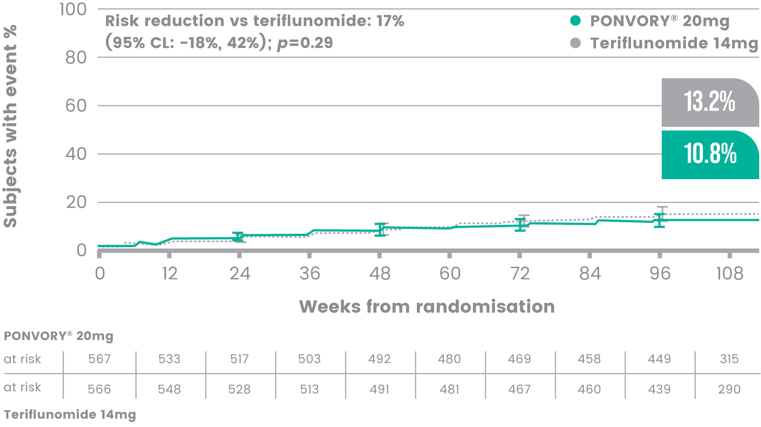
Q2: what are the key efficacy data for PONVORY®?
~90% OF PATIENTS TAKING PONVORY® DID NOT EXPERIENCE DISABILITY PROGRESSION*^{1,2}
OPTIMUM SECONDARY ENDPOINT: Time to 12-week CDA**²
No significant difference on 12-week CDA was observed between PONVORY® and teriflunomide
at Week 108**^{†1-3}
Adapted from: Kappos et al. 2021.
*Reported as change from baseline to EOS; stratified by EDSS category and DMT within 2 years.² **CDA was defined as time to 12-Week/24-Week CDA from baseline
to EOS. A CDA was defined as an increase of at least 1.5 in EDSS for subjects with a baseline EDSS score of 0 or an increase of at least 1.0 in EDSS for subjects with a baseline EDSS score of 1.0 to 5.0, or an increase of at least 0.5 in EDSS for subjects with a baseline EDSS score ≥5.5 which was confirmed after 12 or 24 weeks, respectively.^{1 †}Patients with 12-week CDA=10.8% for PONVORY® 20mg vs. 13.2% for teriflunomide 14mg up to EOS (95% CL: -18%, 42%, p=0.29).¹ The risk of 12-week CDA was not different in the 2 groups, and the formal testing procedure stopped, rendering the subsequent analyses exploratory.^{2,3} Patients with 24-week CDA=8.7% for PONVORY® 20mg vs. 10.5% for teriflunomide 14mg up to EOS (95% CL: -24%, 43%, p=0.37).¹
ARR, annualised relapse rate; CDA, confirmed disability accumulation; CL, confidence limit; DMT, disease-modifying therapy; EDSS, expanded disability status scale; EOS, end of study.
References: 1. European Medicines Agency. Ponesimod Summary of Product Characteristics. Available at: https://www.ema.europa.eu/en/medicines Last accessed: June 2022. 2. Kappos L, et al. JAMA Neurol. 2021; 78(5): 558-567. 3. Kappos L, et al. Supplement 1. JAMA Neurol. 2021; 78(5): 558-567.
Notes:
Dr Guger: In addition, a secondary endpoint from the OPTIMUM study showed that approximately 90% of patients taking PONVORY® did not experience sustained disability progression for 12 weeks over the 2-year study period, but this was not proven to be statistically significant compared to the active comparator.

Slide 14
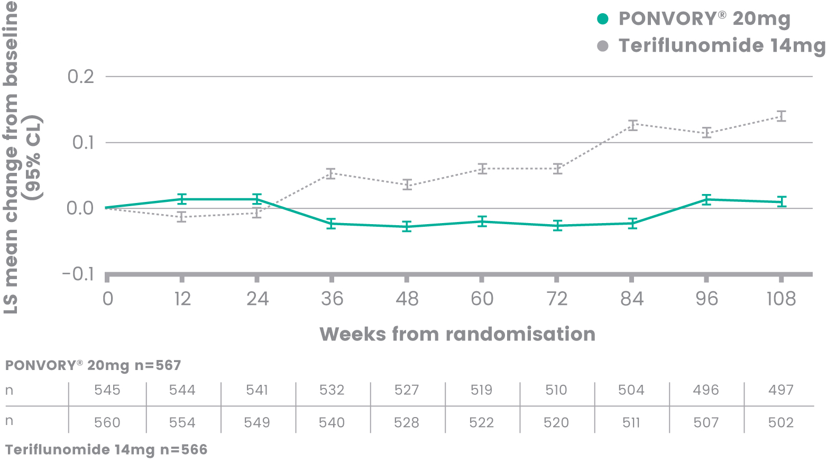
Q2: what are the key efficacy data for PONVORY®?
PONVORY® improved edss score vs. teriflunomide at week 108¹
POST-HOC ANALYSIS FROM OPTIMUM: Mean change in EDSS score¹
The LS mean difference between treatment groups in change from baseline to Week 108 in EDSS score was
-0.13 (95% CL: -0.22,
-0.04; p=0.0059)*¹
*Using a repeated measurements analysis of variance (ANOVA) model (MMRM).¹
ANOVA, analysis of variance; CL, confidence limit; EDSS, expanded disability status scale; LS, least squares; MMRM, mixed model of repeated measures.
References: 1. Fox RJ, et al. Presented at MSVirtual2020: 8th Joint ACTRIMS-ECTRIMS Meeting, 11–13 September 2020. Abstract 0204.
Notes:
Dr Guger: Furthermore, in a post-hoc analysis from the OPTIMUM study, ponesimod was also found to improve EDSS score compared to teriflunomide at Week 108.

Slide 15


Q3: how is agile management defined?
THE PHARMACODYNAMICS AND PHARMACOKINETICS OF S1PR MODULATORS HAVE IMPORTANT CONSIDERATIONS¹⁻⁵
PHARMACODYNAMICS
Treatment with S1PR modulators causes a reduction in blood lymphocyte counts and may increase susceptibility to infections¹⁻⁵
PHARMACOKINETICS
Determines how long it takes to eliminate S1PR modulators from the body¹⁻⁵
S1PR, sphinogosine-1-phosphate receptor.
References: 1. European Medicines Agency. Ponesimod Summary of Product Characteristics. Available at: https://www.ema.europa.eu/en/medicines Last accessed: June 2022. 2. European Medicines Agency. Teriflunomide Summary of Product Characteristics. Available at: https://www.ema.europa.eu/en/medicines Last accessed: June 2022. 3. European Medicines Agency. Fingolimod Summary of Product Characteristics. Available at: https://www.ema.europa.eu/en/medicines Last accessed: June 2022. 4. European Medicines Agency. Ozanimod Summary of Product Characteristics. Available at: https://www.ema.europa.eu/en/medicines Last accessed: June 2022. 5. European Medicines Agency. Siponimod Summary of Product Characteristics. Available at: https://www.ema.europa.eu/en/medicines Last accessed: June 2022.
Notes:
Dr Imtiaz: Thank you. One thing that really stood out to me today as I was visiting the booth was the ‘agility’ aspect of PONVORY®. Can you tell me a bit more about what agility means in the context of a MS treatment?
Dr Guger: That’s a very interesting question. To answer this, we need to look at the pharmacodynamic and pharmacokinetic properties of S1PR modulators. Beginning with the pharmacodynamic profile, treatment with S1PR modulators causes a reduction in blood lymphocyte count, which may increase susceptibility to infections. Alongside this, the pharmacokinetic profile of S1PR modulators will determine how long it takes to eliminate them from the body.

Slide 16
Q3: how is agile management defined?
AGILE MANAGEMENT REFERS TO THE ABILITY TO PAUSE AND RESUME* TREATMENT IF CLINICALLY REQUIRED¹
PROVIDING MORE CONTROL TO TAILOR A PATIENTS’ TREATMENT TO THEIR CHANGING CLINICAL CIRCUMSTANCES^{1,2}
*Severe exacerbations of disease, including disease rebound, have been rarely reported after discontinuation of an S1PR modulator. Patients should be
observed for a severe exacerbation or return of high disease activity upon PONVORY® discontinuation and appropriate treatment should be instituted, as required.¹
S1PR, sphinogosine-1-phosphate receptor.
References: 1. European Medicines Agency. Ponesimod Summary of Product Characteristics. Available at: https://www.ema.europa.eu/en/medicines Last accessed: June 2022. 2. D’Ambrosio D, et al. Ther Adv Chron Dis. 2016;7:18-33.
Notes:
Dr Guger: When we speak about agile management it refers to the ability to pause and resume treatment in instances where this may be clinically required. We can from here conclude that a shorter reversibility profile and washout period could provide an increased flexibility for the doctor to tailor a patients’ treatment to their changing clinical circumstances.

Slide 17


Q4: when could agile management
be clinically required?
AGILE MANAGEMENT COULD HELP ENHANCE THE CONTROL THE PHYSICIAN HAS OVER THEIR PATIENTS’ MS TREATMENT^{1,2}
Important for unexpected events that may impact MS treatment, such as:²
Severe
unexpected infections
Adverse events
Mid-to-long-term
family planning
MS, multiple sclerosis.
References: 1. European Medicines Agency. Ponesimod Summary of Product Characteristics. Available at: https://www.ema.europa.eu/en/medicines Last accessed: June 2022. 2. D’Ambrosio D, et al. Ther Adv Chron Dis. 2016;7:18-33.
Notes:
Dr Imtiaz: Thank you, the concept of agile management is now clear. However, as a follow-up question, you mentioned that there may be instances where agile management could be clinically required. Do you have any examples to give this further context?
Dr Guger: Agile management could help enhance the control we as physicians have over our patients’ MS treatment. Examples of instances where this could be clinically necessary are when unexpected events occur that impact on the MS treatment. For example, a severe unexpected infection is an obvious event that requires agility. Complications associated with certain adverse events is another example that may require agile management. A third example relates to the fact that we mainly treat female patients diagnosed with MS in their 20s and 30s, meaning family planning is a life event that requires careful consideration and the ability to pause treatment. To summarise, agile management could help to strike the balance between providing effective treatment but also allow us to account for our patients’ changing circumstances.

Slide 18

Q5: how does PONVORY® provide agility?
PONVORY® COULD PROVIDE THE AGILITY TO MANAGE THE UNEXPECTED¹
PONVORY® has the fastest reversibility profile compared to other currently available S1PR modulators:¹⁻⁵
  Lymphocyte levels returned to the normal range in above 90% of healthy volunteers within 1 week of stopping treatment with PONVORY®*¹
  In the OPTIMUM Phase III trial, lymphocyte counts were restored within 2 weeks of treatment discontinuation¹
The 7-day washout and
1 to 2 weeks of lymphocyte recovery could give you
the agility to pause and resume** treatment
with PONVORY®
if clinically needed¹
PONVORY® has a short 7-day washout period¹
  Identified metabolites are inactive at S1PRs with therapeutic doses of PONVORY®
*PONVORY® causes a reversible, dose-dependent reduction in peripheral lymphocyte levels. PONVORY® may therefore increase the risk of infections. Monitoring for signs and symptoms of infection should be continued for 1-2 weeks after PONVORY® is discontinued.¹ **Severe exacerbations of disease, including disease rebound, have been rarely reported after discontinuation of an S1PR modulator. Patients should be observed for a severe exacerbation or return of high disease activity upon PONVORY® discontinuation and appropriate treatment should be instituted, as required.¹
S1PR, sphinogosine-1-phosphate receptor.
References: 1. European Medicines Agency. Ponesimod Summary of Product Characteristics. Available at: https://www.ema.europa.eu/en/medicines Last accessed: June 2022. 2. European Medicines Agency. Teriflunomide Summary of Product Characteristics. Available at: https://www.ema.europa.eu/en/medicines Last accessed: June 2022. 3. European Medicines Agency. Fingolimod Summary of Product Characteristics. Available at: https://www.ema.europa.eu/en/medicines Last accessed: June 2022. 4. European Medicines Agency. Ozanimod Summary of Product Characteristics. Available at: https://www.ema.europa.eu/en/medicines Last accessed: June 2022.
5. European Medicines Agency. Siponimod Summary of Product Characteristics. Available at: https://www.ema.europa.eu/en/medicines Last accessed: June 2022.
Notes:
Dr Imtiaz: That makes perfect sense, thank you. I’m now clear on how agile management is defined and examples of when it could be useful. However, I’m still not entirely clear on how PONVORY® is different to other similar treatments. Maybe you could elaborate more on exactly how PONVORY® provides agility?
Dr Guger: As a starting point, I should explain that PONVORY® is a DMT of S1PR modulator class, which through selective interaction with the S1P receptor 1 blocks the egress of lymphocytes from lymph nodes. This results in a decrease in peripheral lymphocyte count and may also reduce inflammatory cell infiltration of the central nervous system.
The key difference of PONVORY® compared to other S1PR modulators is that it has the fastest reversibility profile. After stopping treatment with PONVORY®, pharmacodynamic modelling has indicated that the lymphocyte levels returned to the normal range within 1-2 weeks.
Now, looking at the pharmacokinetic profile of PONVORY®, it shows a short 7-day washout period, meaning it leaves the body naturally within 1 week of treatment discontinuation. In addition, no active metabolites were found.
Taken together, the fast 7-day washout and 1 to 2 weeks of lymphocyte recovery could give us the agility to quickly pause and resume treatment with PONVORY® if clinically needed.

Slide 19
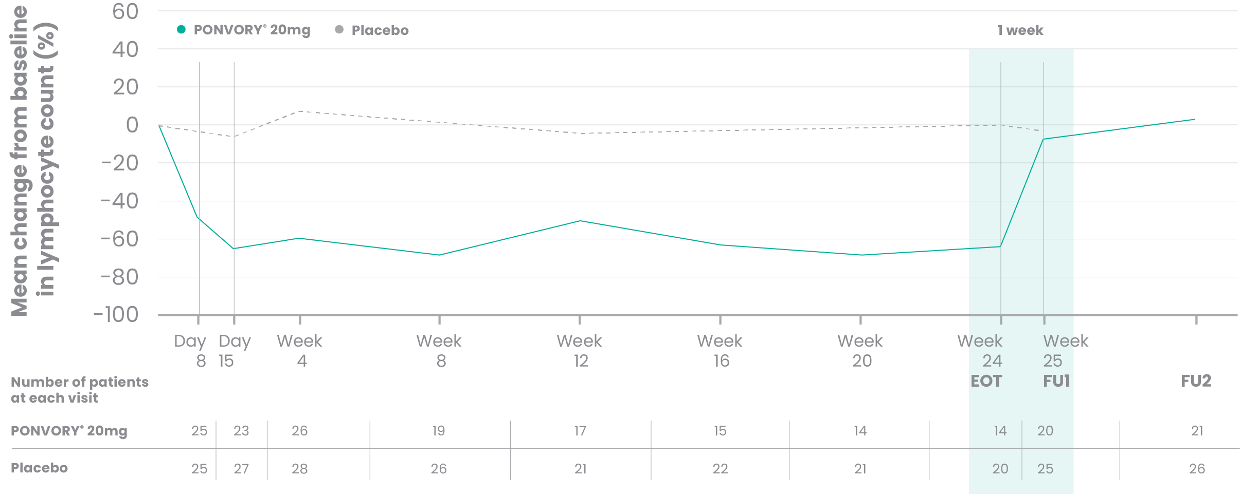
Q5: how does PONVORY® provide agility?
PONVORY® has a fast onset of action with rapid reduction in lymphocytes^{1,2}
Change in lymphocyte counts from baseline to Week 24 (Phase IIb)²
FU1=EOT + 7 days. FU2=EOT + 30 days. Adapted from Olsson et al. 2014.
EOT, end of treatment; FU, follow-up.
References: 1. European Medicines Agency. Ponesimod Summary of Product Characteristics. Available at: https://www.ema.europa.eu/en/medicines
Last accessed: June 2022. 2. Olsson T et al. J Neurol Neurosurg Psychiatry. 2014;85(11):1198-1208.
Notes:
Dr Guger: On the other hand, when initiating treatment with PONVORY®, it shows fast onset of action with the lymphocyte levels reaching their lowest counts within 1 to 2 weeks.

Slide 20

Q6: what are the potential benefits of agility that PONVORY® provides in clinical practice?
PONVORY® COULD PROVIDE POTENTIAL AGILITY BENEFITS IN CLINICAL PRACTICE¹
Balance patients’ needs for effective treatment with their life events, such as:¹⁻³
  Managing severe unexpected infections¹
  Allowing for mid-to-long-term family planning¹
For clinicians, PONVORY® could help them adapt treatment to the needs of their patients^{1,3}
  Flexibility to tailor treatment to unique patient circumstances¹⁻³
  Support with providing consistent agile management to your patients¹
References: 1. European Medicines Agency. Ponesimod Summary of Product Characteristics. Available at: https://www.ema.europa.eu/en/medicines Last accessed: June 2022. 2. Mortensen GL, et al. Patient Prefer Adherence. 2017;11:1789-1796. 3. D’Ambrosio D, et al. Ther Adv Chron Dis. 2016;7:18-33.
Notes:
Dr Imtiaz: At this point, I’ve understood how PONVORY® can provide agility. For my next question I wanted to ask, thinking about your clinical practice, what patients do you think could benefit from agile management with PONVORY®?
Dr Guger: As we have already touched on, it is natural that the treatment preferences of patients living with MS are influenced by everyday-related factors and will evolve over time based on their individual circumstances. I would like to emphasise again, that the agility to pause the treatment with PONVORY® if clinically needed could be helpful to allow for patients to balance their needs for effective treatment with their life events. This is of particular importance to patients who consider family planning a priority or where there are concerns about severe unexpected infections.
Dr Imtiaz: Thank you for sharing your thoughts. I’d also be interested in knowing if agile management brings any benefits to clinicians?
Dr Guger: We as clinicians have an important role to ensure control of our patients’ MS treatment and to manage our patients appropriately in unique individual circumstances. This could include supporting patients to navigate the uncertainty around switching or stopping treatment, either temporarily or permanently. PONVORY® could help us tailor our patients’ treatment to their needs, which in turn could help us to provide consistent agile management to our patients.

Slide 21
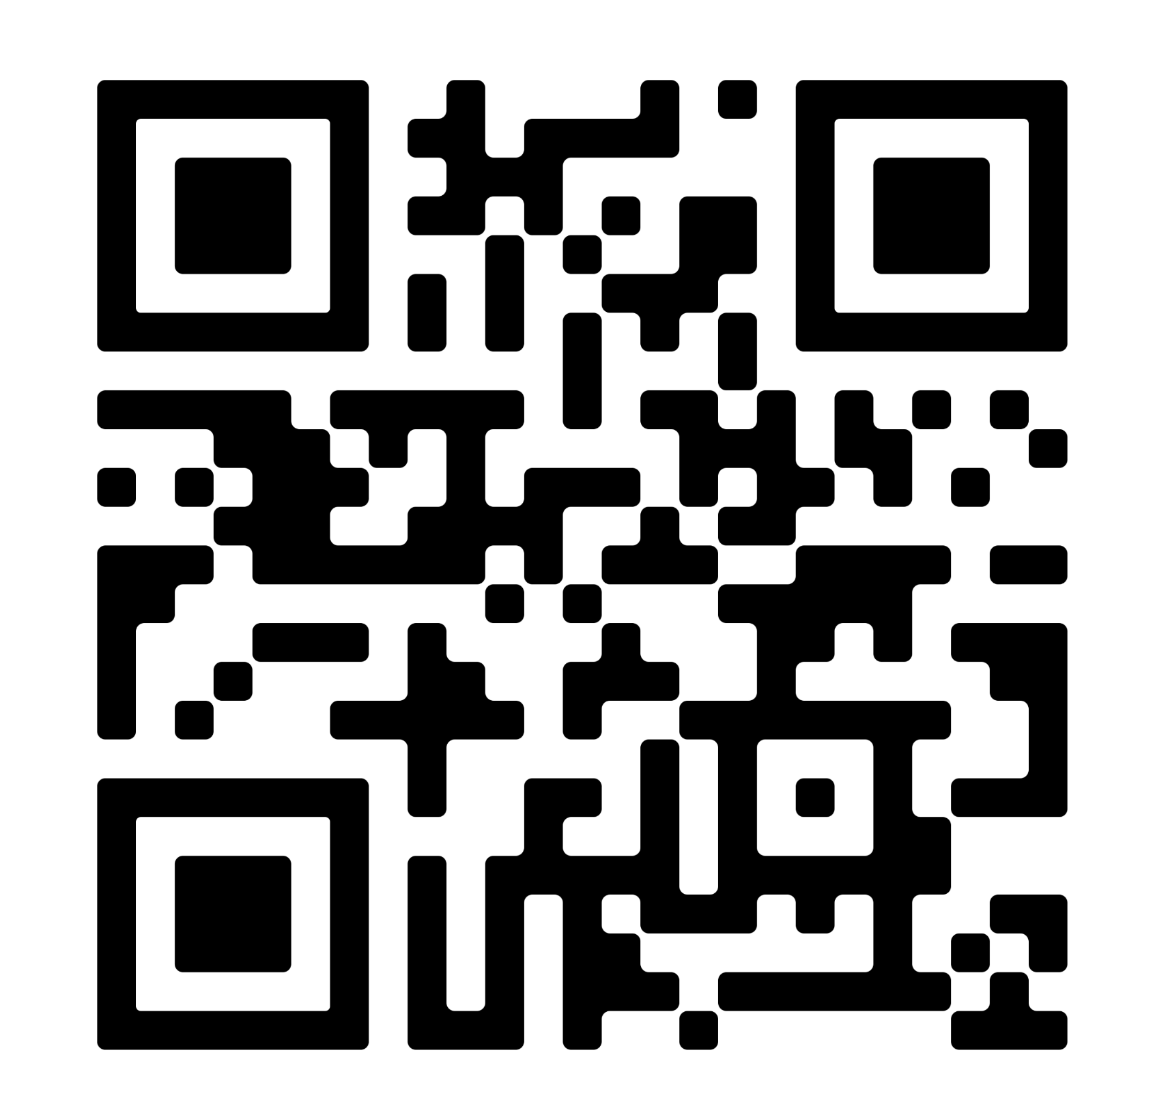
THANK YOU
Scan here
to receive communications
from Janssen
Any questions?
Notes:
Dr Imtiaz: Thank you for sharing your perspective. The discussion around agile management with PONVORY® has been very fruitful and informative. I would now like to invite members of the audience to ask any additional questions?

Slide 22
Q&A session
?
    COVID-19 vaccination
    Re-activation/rebound
    DMT comparison

Slide 23
Q&A SESSION
BACK TO CONTENTS
Limited clinical data suggest that S1PR modulators may impact
the humoral immune response to non-live vaccines, including those for COVID-19^{1,2}
In an ongoing Phase IIb LTE study, blood samples are being collected and analysed to assess the humoral response* to COVID-19 vaccinations in adult active RMS patients treated with PONVORY® 20mg²
The majority (>80%) of patients appeared to develop a measurable SARS-CoV-2 humoral response* after COVID-19 vaccination²
20 (14.9%) and 17 (12.7%) patients reported pre-vaccination and post-vaccination AEs of COVID-19 infection, respectively. None of these AEs were serious, severe or fatal, and none led to permanent treatment discontinuation²
Further investigations on the efficacy and safety of COVID-19 vaccination in MS patients on PONVORY® are warranted²
What data is available on COVID-19 vaccination in patients on PONVORY®?
*Response to vaccination was defined as seroconversion in case of negative pre-vaccination antibody testing, or a 4-fold antibody concentration increase in case of a positive pre-vaccination antibody result.²
AE, adverse event; LTE, long-term extension; MS, multiple sclerosis; RMS, relapsing multiple sclerosis; S1PR, sphinogosine-1-phosphate receptor.
References: 1. European Medicines Agency. Ponesimod Summary of Product Characteristics. Available at: https://www.ema.europa.eu/en/medicines Last accessed: June 2022. 2. Wong J, et al. COVID-19 Vaccine Antibody Response in RMS Patients Treated with Ponesimod: Results from the Long-Term Extension Study AC-058B202. Presented at CMSC Annual Meeting, National Harbor, Maryland, US. 01-04 June 2022.

Slide 24
Q&A SESSION
BACK TO CONTENTS
Re-activation response: In line with the reversible nature
of S1PR modulators, it is expected that if treatment is discontinued, re-activation could occur¹
Rebound response: Systematic review of the available serious adverse event reports from patients discontinuing the drug during OPTIMUM, the Phase II study, and its extension follow-up phase have not revealed any reports of rebound or severe relapses after discontinuation of PONVORY^{®2}
Severe exacerbations of disease, including disease rebound, has rarely been reported after discontinuation of an S1PR modulator. The possibility of severe exacerbation of disease should be considered after stopping treatment and monitoring of the patient is recommended so appropriate treatment can be re-instated as required³
If my patients stops taking treatment, will there be re-activation and/or rebound of symptoms?
S1PR, sphingosine-1-phosphate receptor.
References: 1. Berger B., et al. J Neuroimmunol. 2015;282:118-122. 2. Kappos L., et al. JAMA Neurol. 2021;78(5):558-567. 3. European Medicines Agency. Ponesimod Summary of Product Characteristics. Available at: https://www.ema.europa.eu/en/medicines Last accessed: June 2022.

Slide 25
Q&A SESSION
BACK TO CONTENTS
How do other DMTs compare to PONVORY® with respect to washout and lymphocyte count reversibility?
 | Washout | T1/2 | Lymphocyte count reversibility
Ozanimod¹ | 3 months | 21 hours T1/2 active metabolites: 11 days | Median: 30 days
Fingolimod² | up to 2 months | 6-9 days | 1-2 months
Siponimod³ | 10 days | 30 hours | 10 days
Teriflunomide⁴ | 3.5 months, and may be longer in some patients | 19 days | -
Dimethyl fumarate⁵ | 1 day | 1 hour | Lymphocyte counts should be followed until recovery
Cladribine⁶ | 4 weeks | 1 day | 84-144 weeks from first dose
Natalizumab⁷ | 12 weeks | 26.8 days | -
Ofatumumab⁸ | N/A | 16 days | Median time to B-cell recovery: 24.6 weeks
Ocrelizumab⁹ | N/A | 26 days | Median time to B-cell repletion: 72 weeks
DMT, disease-modifying therapy.
References: 1. Zeposia (ozanimod). Summary of Product Characteristics. December 2021. 2. Gilenya (fingolimod). Summary of Product Characteristics. March 2022. 3. Mayzent (siponimod). Summary of Product Characteristics. February 2022. 4. Aubagio (teriflunomide). Summary of Product Characteristics. January 2022. 5. Tecfidera (dimethyl fumarate). Summary of Product Characteristics. May 2022. 6. Mavenclad (cladribine). Summary of Product Characteristics. May 2022. 7. Tysabri (natalizumab). Summary of Product Characteristics. June 2022. 8. Kesimpta (ofatumumab). Summary of Product Characteristics. March 2022. 9. Ocrevus (ocrelizumab). Summary of Product Characteristics. February 2022.

Slide 26
Q&A session
?
    Convenience
    Missed/forgotten doses
    Safety
    Pregnancy

Slide 27
Q&A SESSION
BACK TO CONTENTS
Once-daily PONVORY® can be initiated at home for most patients*¹
First-dose observation is only recommended for select
patients with pre-existing cardiac conditions*¹
Dose titration is required for initiation of treatment with PONVORY® to mitigate first-dose effects²
The 14-day treatment initiation pack is designed to simplify titration¹
PONVORY® is an oral, once daily tablet that is discreet and
can be taken anywhere, unlike infusions or injections¹
After dose titration, the recommended maintenance dosage
is one 20 mg tablet taken once-daily¹
Can be taken with or without food¹
Can you expand on the convenience aspect of PONVORY®?
*4-hour first-dose observation is recommended for patients with sinus bradycardia, first- or second-degree AV blocks, Mobitz type I (Wenckebach), or a history of myocardial infarction or heart failure occurring more than 6 months prior to treatment initiation and in a stable condition.¹
AV, atrioventricular.
References: 1. European Medicines Agency. Ponesimod Summary of Product Characteristics. Available at: https://www.ema.europa.eu/en/medicines Last accessed: June 2022. 2. Kappos L, et al. JAMA Neurol. 2021; 78(5): 558-567.

Slide 28
Q&A SESSION
BACK TO CONTENTS
Interruption during treatment, especially during titration, should be avoided¹
If less than 4 consecutive doses are missed during initiation or maintenance, your patient can resume treatment with the first missed dose¹
If 4 or more consecutive doses are missed during initiation or maintenance, reinitiate with Day 1 of a new treatment initiation pack, and complete the first-dose observation in patients for whom it is recommended*¹
What happens if my patient misses or forgets to take a dose?
*The same first-dose observation for treatment initiation is recommended when ≥4 consecutive doses are missed in patients with pre-existing cardiac conditions.¹
References: 1. European Medicines Agency. Ponesimod Summary of Product Characteristics. Available at: https://www.ema.europa.eu/en/medicines Last accessed: June 2022.

Slide 29
Q&A SESSION
BACK TO CONTENTS
The safety results for PONVORY® from the large Phase III OPTIMUM study were in line with previous observations in
its Phase II dose-finding study and the known profile of other S1PR modulators¹
  Overall, the proportion of patients experiencing at least 1 TEAE or SAE was similar between the two treatment groups¹
In the Phase III OPTIMUM study, the cardiac adverse events on Day 1 were neither serious nor led to permanent discontinuation of treatment¹
  In all patients, a gradual up-titration is used for initiation of PONVORY® treatment to mitigate first-dose effects¹
PONVORY® has long-term safety data extending up to 9 years in a Phase II study*²
PONVORY® has a low risk of drug-drug interactions with
beta-blockers, inhibitors of major CYP or UGT enzymes or transporters, and hormonal contraceptives**³
Can you expand on the safety profile of PONVORY®?
*Based on data from a Phase II (plus long-term extension [LTE]) study to investigate the long-term safety, tolerability, and efficacy of PONVORY® in patients with RMS.² **Caution should be applied when PONVORY® is initiated in patients receiving treatment with a beta-blocker because of the additive effects on lowering heart rate; temporary interruption of the beta-blocker treatment may be needed prior to initiation of PONVORY®. Beta-blocker treatment can be initiated or reinitiated after PONVORY® has been up-titrated to the target maintenance dose.³
CYP, cytochrome P450; LTE, long-term extension; RMS, relapsing multiple sclerosis; S1PR, sphinogosine-1-phosphate receptor; SAE, serious adverse event;
TEAE, treatment-emergent adverse event; UGT, uridine 5’-diphospho-glucuronosyltransferase.
References: 1. Kappos L, et al. JAMA Neurol. 2021; 78(5): 558-567. 2. Freedman MS, et al. Presented at ACTRIMS-ECTRIMS (MS Virtual 2020). 11-13 September 2020. P37. 3. European Medicines Agency. Ponesimod Summary of Product Characteristics. Available at: https://www.ema.europa.eu/en/medicines Last accessed: June 2022.

Slide 30
Q&A SESSION
BACK TO CONTENTS
PONVORY® should not be used during pregnancy. It is contraindicated during pregnancy and in women of childbearing potential not using effective contraception¹
A negative pregnancy test must be available before initiation of treatment in women of childbearing potential and testing must be repeated at suitable intervals during treatment¹
Since it takes approximately 1 week to eliminate PONVORY® from the body after stopping treatment, the potential risk to
the foetus may persist. So women should take effective contraception during this period¹
If your patient becomes pregnant during treatment, PONVORY® must be immediately discontinued¹
It is unknown whether PONVORY® is excreted in human milk; therefore, a risk to newborns and infants cannot be excluded. Your patients receiving PONVORY® should not breastfeed¹
Can PONVORY® be used during pregnancy?
References: 1. European Medicines Agency. Ponesimod Summary of Product Characteristics. Available at: https://www.ema.europa.eu/en/medicines Last accessed: June 2022.

Slide 31
THANK YOU
Scan here
to receive communications
from Janssen
Notes:
Dr Imtiaz: Once again, I would like to thank Dr Guger for his participation and the audience for their contributions to the discussion. Change to next slide to end on PI

Slide 32
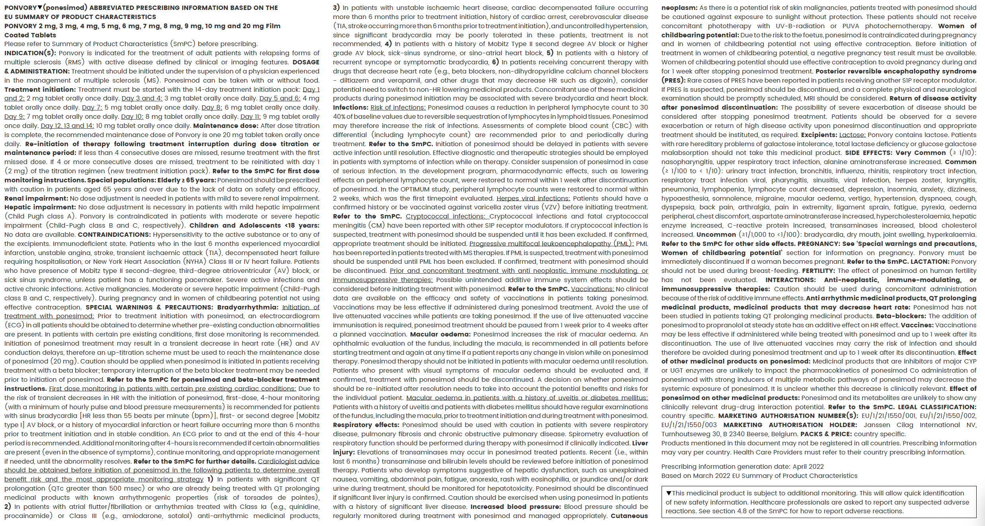
PRESCRIBING INFORMATION

